Slide 1
Food Deserts Related to Crimes
Project 1 – GT Data Analytics Bootcamp
Team Neighborhood Crime Watch:
Hayden HintoN, Jeanne Aulbach, Vince baria, leKh malla
February 12, 2022
Hayden

Slide 2
Hypothesis
There is a correlation between food deserts and crime rates. We would expect to see higher crime rates in food deserts.
There are current studies that show correlation between food deserts and poverty.
We wanted to see if food deserts correlated to any other variable such as crime.
Jeanne

Slide 3
Definitions
Food Desert: An urban area in which it is difficult to buy affordable or good-quality fresh food.
NPU: Neighborhood Planning Unit as defined by the City of Atlanta. It incorporates multiple neighborhoods into groups.
Grocery Store: The classification was chosen as opposed to convenience stores or fast food restaurants because of the emphasis on healthy food.
Jeanne

Slide 4
Data Sources
Grocery Store Data: Yelp API
Crime Data: City of Atlanta crimes that occured during 2021 regardless of when reported, downloaded from Atlanta Police Department
NPU Data: City of Atlanta ArcGIS
Lekh & Hayden

Slide 5
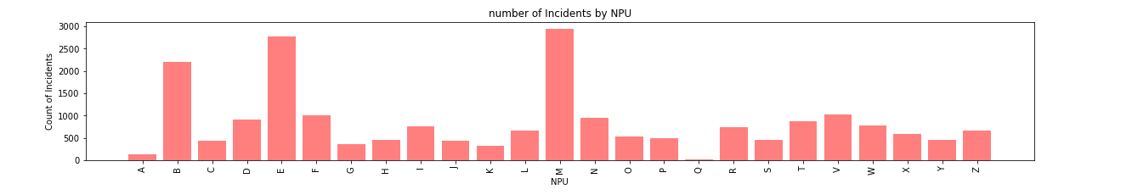
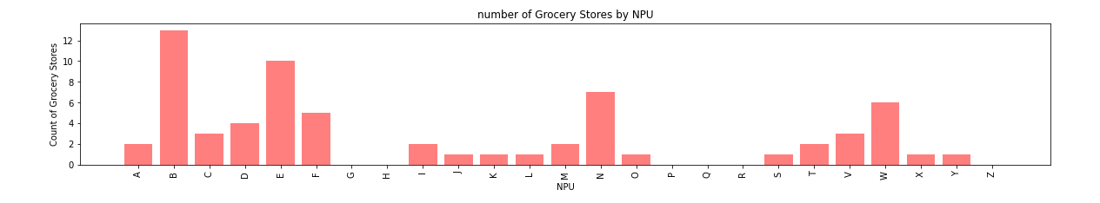
Counts of Each Data Set per NPU
Vince

Slide 6
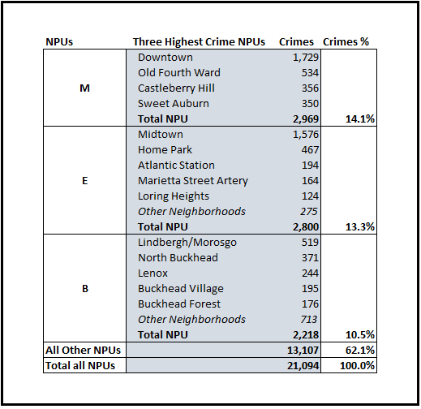
Top Three NPU’s - Crimes
Vince

Slide 7
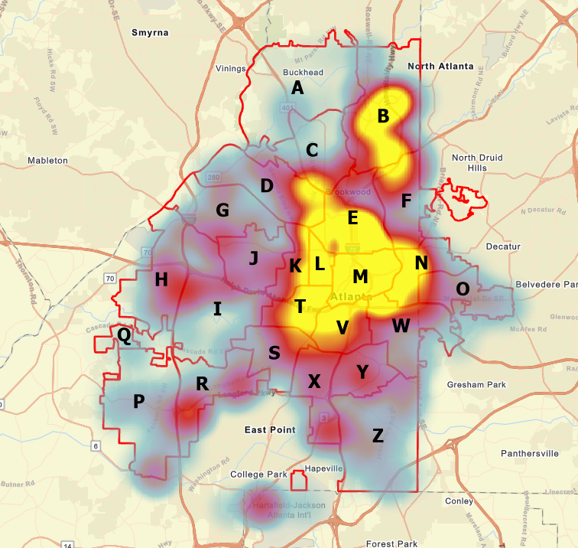
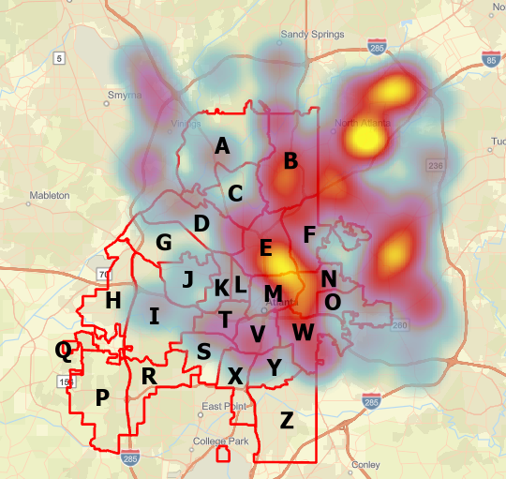
Comparison of Crime and Grocery Locations
Crime
Groceries
Hayden

Slide 8
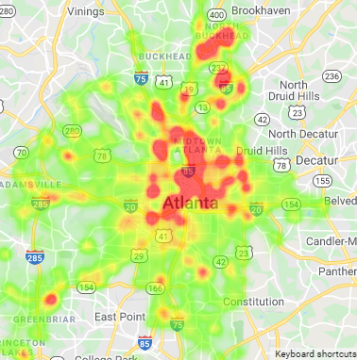
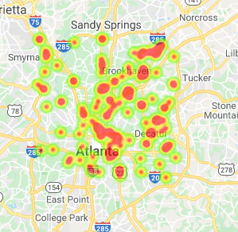
Generated Crime Heat Map Using GMAPS
Crime
Groceries
Lekh

Slide 9
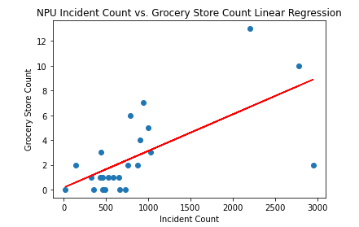
Trendline of Correlation
B
r-squared = 0.66
E
M
Hayden

Slide 10
Conclusions
There is a correlation between the location of grocery stores and crimes.
The correlation shows that generally where there are more grocery stores there is more crime, not the opposite, as we hypothesized.
Note: Correlation does not necessarily imply causation.
The numbers were not adjusted for population, which could impact the outcome of our analysis.
It would be interesting to see if the type of crime would have an impact on the outcome.
Jeanne, Hayden & Vince

